Slide 1
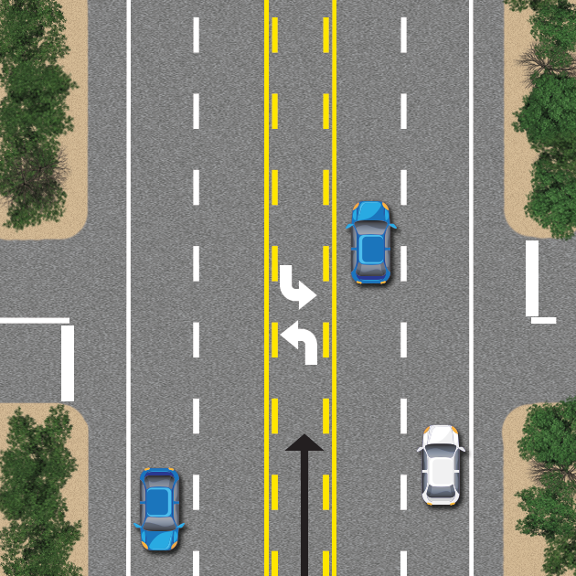
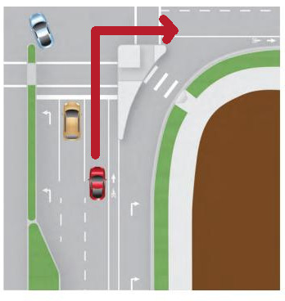
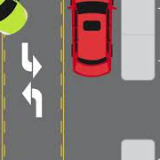

Multi-stage Deep Learning Technique with a Cascaded Classifier for Turn Lanes Recognition
IEEE Symposium Series on Computational Intelligence (IEEE SSCI 2021)
Authors:
Pubudu Sanjeewani (Presenting Author)
Brijesh Verma
Joseph Affum
Source: Google Images

Slide 2
Introduction
The main purpose is to develop an Australian Road Assessment Program (AusRAP) attribute detection system.
The goal of AusRAP attribute detection system is to detect and identify all road attributes to assess road safety.
The accurate recognition of road markings is required in many applications including autonomous vehicles.
Most of the research which exists on the detection and classification of turn lane arrows have many limitations including low accuracy
We propose a novel technique for automatic detection and recognition of turn lane road markings.
Three turn lane road markings named left turn lane, right turn lane and Continuous Central Turning Lane (CCTL) are evaluated.

Slide 3
What is Proposed ?
We propose,
a Fully Convolutional Network (FCN) with all turn lane arrows into one class to segment turn lane arrow pixels into Region of Interests (RoIs) for accurately identifying turn lane arrows in our AusRAP safety attributes detection system,
a novel evolving cascaded classifier that classifies detected pixels into individual turn lane arrows or non-arrows, and
an evaluation of the proposed technique on a real-world industry dataset conducting large number of experiments and comparative analysis.

Slide 4
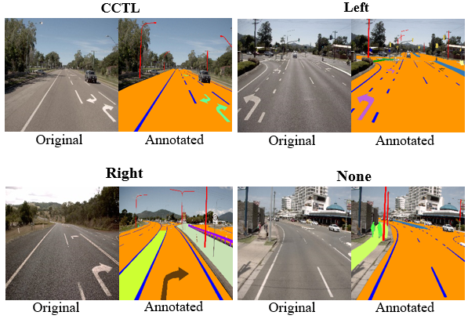
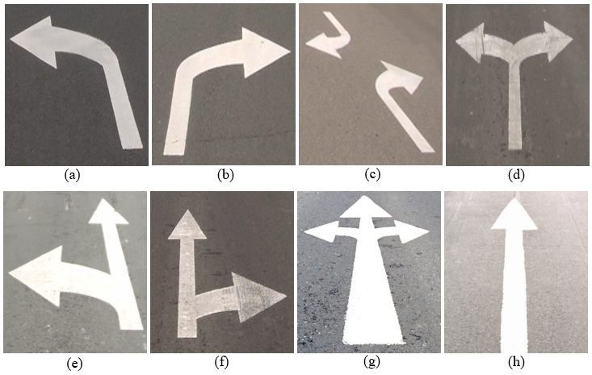
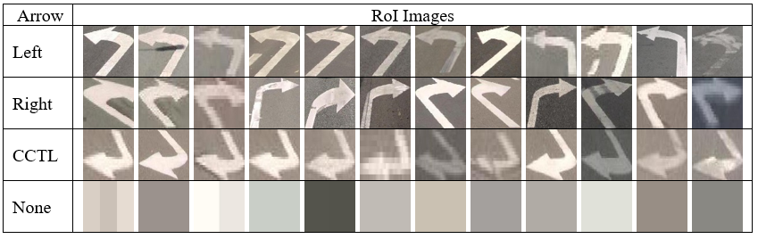
Data Preparation
Fig. 1: Different Types of Arrow Markings on Road
Fig. 2: Turn Lane Arrow Frames and Corresponding Annotations
Fig. 3: RoI Images Input to Cascaded Classifier

Slide 5
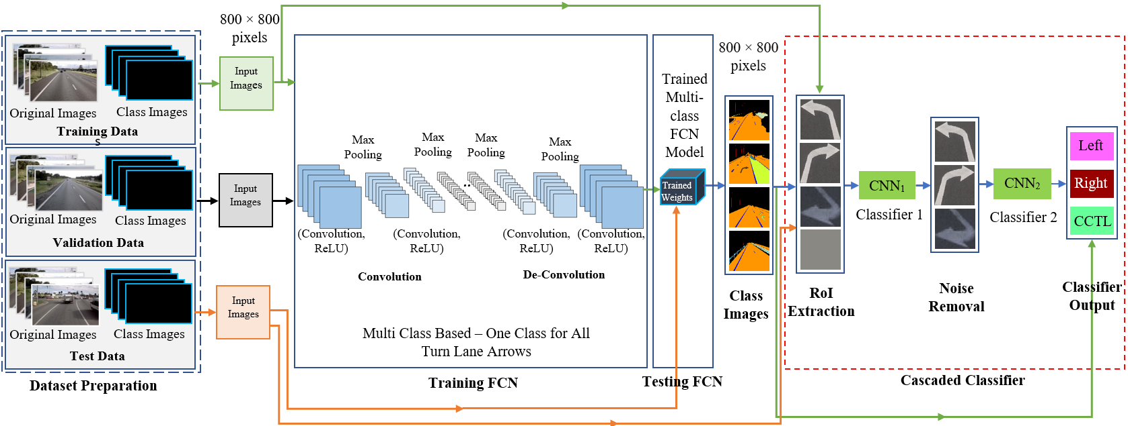
Proposed Technique
Fig. 4: Proposed Technique

Slide 6
Process for Cascaded Classifier Training
Step 1: Prepare (pre-processing and resizing) RoIs used for training and testing the first classifier with two classes (arrow, noise).
Step 2: Load the training (80% of the training data), validation (20% of the training data) and testing data.
Step 3: Define initial parameters for the first classifier model.
Step 4: Train the first classifier model.
Step 5: Visualize the results.
Step 6: Save the best model.
Step 7: Analyze the model on testing data and remove images with noise (false arrow detection) from the testing data.
Step 8: Prepare (pre-processing and resizing) RoIs used for training and testing the second classifier with three classes (left turn lane, right turn lane and CCTL).
Step 9: Train the second classifier model.
Step 10: Visualize the results.
Step 11: Save the best model.
Step 12: Evaluate the second classifier model with noise removed test data.

Slide 7
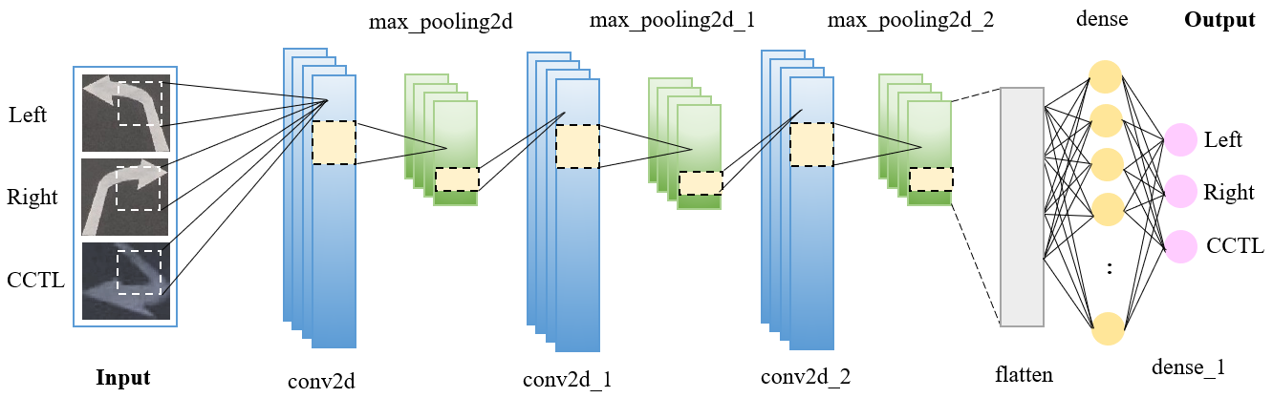
Architecture of the Second Classifier in the Proposed Cascaded Classifier
Fig. 5: Architecture of the Second Classifier in the Proposed Cascaded Classifier

Slide 8
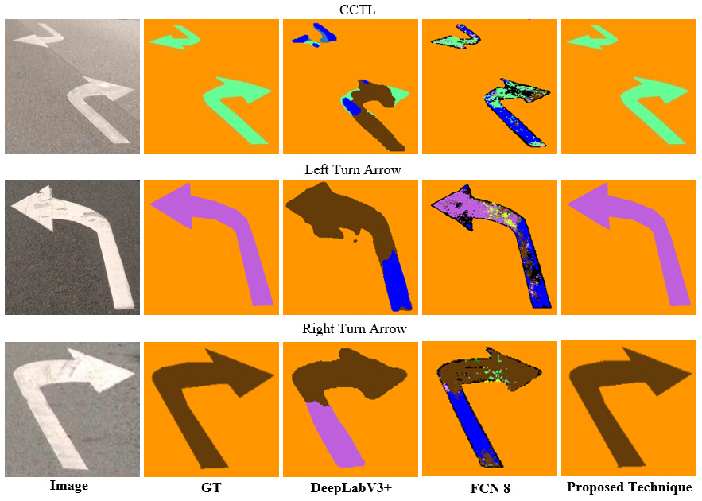
Visual Results
Fig. 6: Sample Prediction Results Obtained by DeepLabV3+, FCN8 and the Proposed Technique

Slide 9
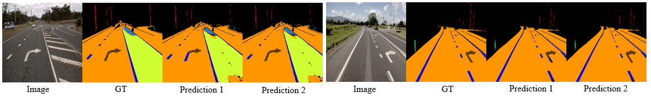
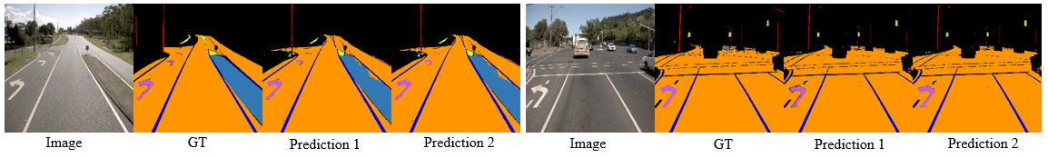
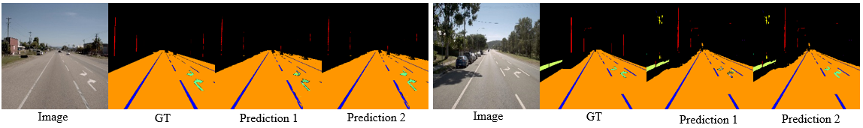
Continued..
Fig. 7: Prediction Results of Right Turn Arrow Obtained by Multi-class Turn Lane Arrow Model (Prediction 1) and the Proposed Technique (Prediction 2)
Fig 8: Prediction Results of Left Turn Arrow Obtained by Multi-class Turn Lane Arrow Model (Prediction 1) and the Proposed Technique (Prediction 2)
Fig. 9: Prediction Results of Left Turn Arrow Obtained by Multi-class Turn Lane Arrow Model (Prediction 1) and the Proposed Technique (Prediction 2)

Slide 10
Numeric Results
Table 1: Best Accuracy Obtained by the FCN Classification Technique
Table 2: Best Accuracy Obtained by DeepLabV3+ Technique
Turn Lane Arrow | Accuracy (%)
 | Attribute wise | Pixel wise
CCTL | 71.06 | 82.00
Left | 72.00 | 56.97
Right | 56.59 | 48.00
Turn Lane Arrow | Accuracy (%)
 | Attribute wise | Pixel wise
CCTL | 44.75 | 74.00
Left | 52.00 | 50.00
Right | 43.41 | 50.97
Table 3: Best Accuracy Obtained by the Proposed Technique
Turn Lane Arrow | Accuracy (%)
CCTL | 100.00
Left | 90.38
Right | 90.57

Slide 11
Comparative Analysis
Table 4: Comparison of Classification Accuracy
Turn Lane Arrow | Attribute Wise Accuracy (%)
 | Proposed technique | GA Classifier | DeepLabV3+ | FCN8
CCTL | 100.00 | 100.00 | 44.75 | 71.06
Left | 90.38 | 80.77 | 52.00 | 72.00
Right | 90.57 | 81.13 | 43.41 | 56.59
Average | 93.65 | 87.30 | 46.72 | 66.55

Slide 12
Conclusion and Future Work
A novel technique for detection and classification of turn lane road markings is presented.
The technique has been implemented and evaluated on a large real-world dataset from industry.
Comparative analysis shows that the proposed technique produces the best classification accuracy and minimum misclassifications compared to FCN8 and DeepLabV3+ with majority pixel-based classifier.
The overall accuracy achieved by the proposed technique is 93.65% which is much higher than accuracy obtained by other existing techniques. (GA classifier – 87.30%, FCN8 - 66.55%, DeepLabV3+ - 46.72%).
In our future work, road marking detection will be further extended by adding other road markings such as pedestrian crossing, central hatching, dedicated bicycle lanes, parking slots, rumble strip, etc.
Attributes other than road markings similar in color, size and shape will be investigated by further improving the performance of the proposed technique.

Slide 13
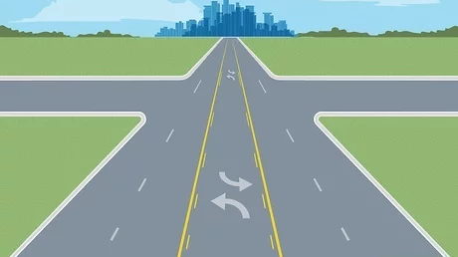
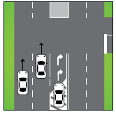
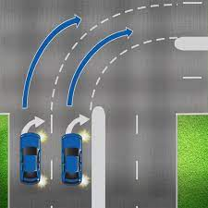
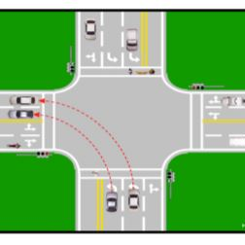
Thank You
Source: Google Images

Slide 14
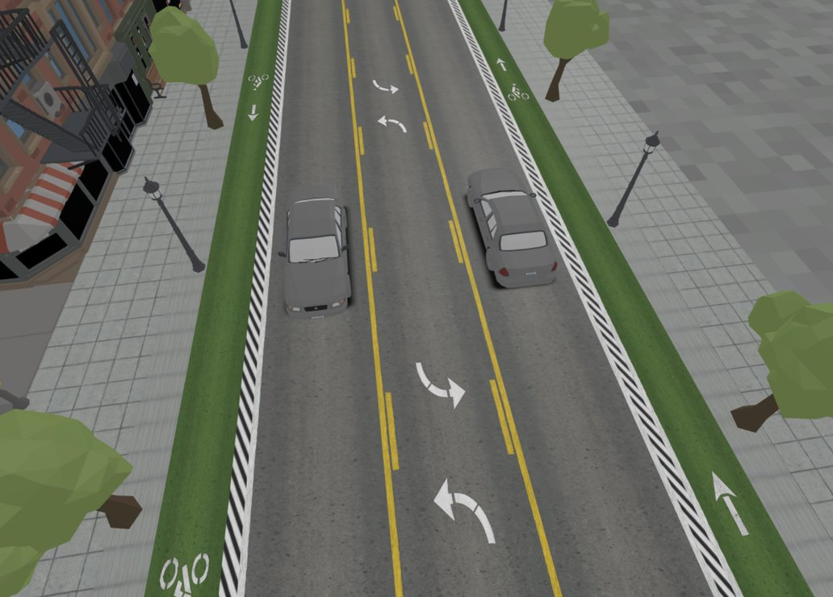
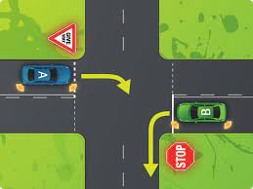
Q&A
Source: Google Images

Slide 15
Supplementary Slides

Slide 16
Architectural Parameters for the Proposed Classifiers
Table 5: Architectural Parameters for the Proposed Classifiers
Layer | Activation Function | Padding | Kernal Size | Output Size | Parameters
rescaling_1 (Rescaling) | - | - | - | (None, 180, 180, 3) | 0
conv2d (Conv2D) | ReLU | Same | 3 | (None, 180, 180, 16) | 448
max_pooling2d (MaxPooling2D) | - | - | 2 | (None, 90, 90, 16) | 0
conv2d_1 (Conv2D) | ReLU | Same | 3 | (None, 90, 90, 32) | 4,640
max_pooling2d_1 (MaxPooling2D) | - | - | 2 | (None, 45, 45, 32) | 0
conv2d_2 (Conv2D) | ReLU | Same | 3 | (None, 45, 45, 64) | 18,496
max_pooling2d_2 (MaxPooling2D) | - | - | 2 | (None, 22, 22, 64) | 0
flatten (Flatten) | - | - | - | (None, 30976) | 0
dense (Dense) | ReLU | - | - | (None, 128) | 3,965,056
dense_1 (Dense) | - | - | - | (None, 5) | 645

Slide 17
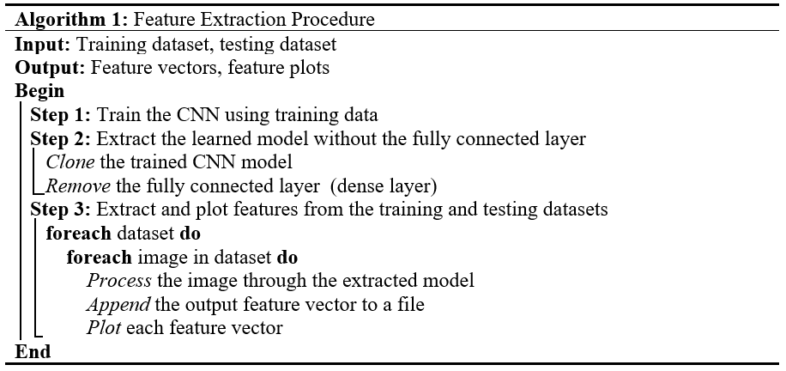
Training and Feature Extraction Procedure

